Slide 1
PI-20 OSS Community Meeting Zanzibar, Tanzania 26 Oct 2022 Thynn Win, Aung Thaw Aye
WynePay Deployment Update

Slide 2



ThitsaWorks
ThitsaWorks provides financial technology solutions for Microfinance Institutions to collect, manage and analyze data needed to run effective operations and to manage risks.
Our Mission... Powering financial inclusion!
Our team
MYANMAR
ThitsaWorks Solutions Myanmar Co., Ltd.
No. 28 (A), Kyauk Kone Street, Room#701
Sky View Tower, Yankin Township, Yangon 11081
SINGAPORE
ThitsaWorks Pte. Ltd.
160 Robinson Road, #14-04
Singapore Business Federation Centre
Singapore 068914

Slide 3
WynePay Phases
LIVE
Live
Closed User Group
Everyone
Some controlled users
CUG
FUT
Friendly User Testing
Employees of MFIs
3

Slide 4
Agenda
Deploying Hub Environments
Design Decisions and Lessons Learned
01
Empowering DFSPs
Self-hosted Payment Manager for Mojaloop (PM4ML)
02
03
Making WynePay more inclusive
Payment Portal for MFI
4

Slide 5
Deploying Hub Environments
Design Decisions and Lessons Learned

Slide 6
Deploying Hub Envs from scratch
Plan
AWS Account
AWS Account
Use separate AWS account for each HUB environment.
Tenant
Tenant
Environment
UAT
Environment
Production
Environment
Staging
6

Slide 7
Deploying Hub Envs from scratch
Plan
Setup a domain name with Route53 public hosted zone
Configure EBS’s size to be 500GB and share 100 GB of it to Loki log storage.
Verify with /parties and /quote API calls after onboarding is done.
Prepare SOPs and Runbooks
Update log retention to 90days for Production Environment. (default is 72 hr)
Not to onboard internal PM4ML in Prod.
Disable unattended-upgrades to avoid random reboot, after deploying Tenant/HUB/PM4ML
Verify with checklists.
7

Slide 8


Deploying Hub Envs from scratch
Execution
Launch a Hub environment in 2 days.
04
Test & Onboard DFSPs
03
Deploy
the Hub
02
Setup GitLab
CI/CD
01
Configure from bootstrap

Slide 9
Deploying Hub envs from scratch
Lessons Learned
Docker hub rate limit issue:
We couldn’t build two envs (UAT and Stg) on the same day because Docker Hub has a rate limit of 100 pulls per 6hrs per IP address.
PM4ML scalability issue: Current IaC supports ONE master node and unable to support for HA.
Internal PM4ML installation required:
Even though we don't require internal PM4ML for Prod, we needed to build the internal PM4ML.
Default AWS EIP limitation:
Only 5 EIPs by default, and requested for 20 EIPs

Slide 10
Empowering DFSPs
Self-hosting Payment Manager for Mojaloop (PM4ML)
Notes:
Please let me continue…

Slide 11
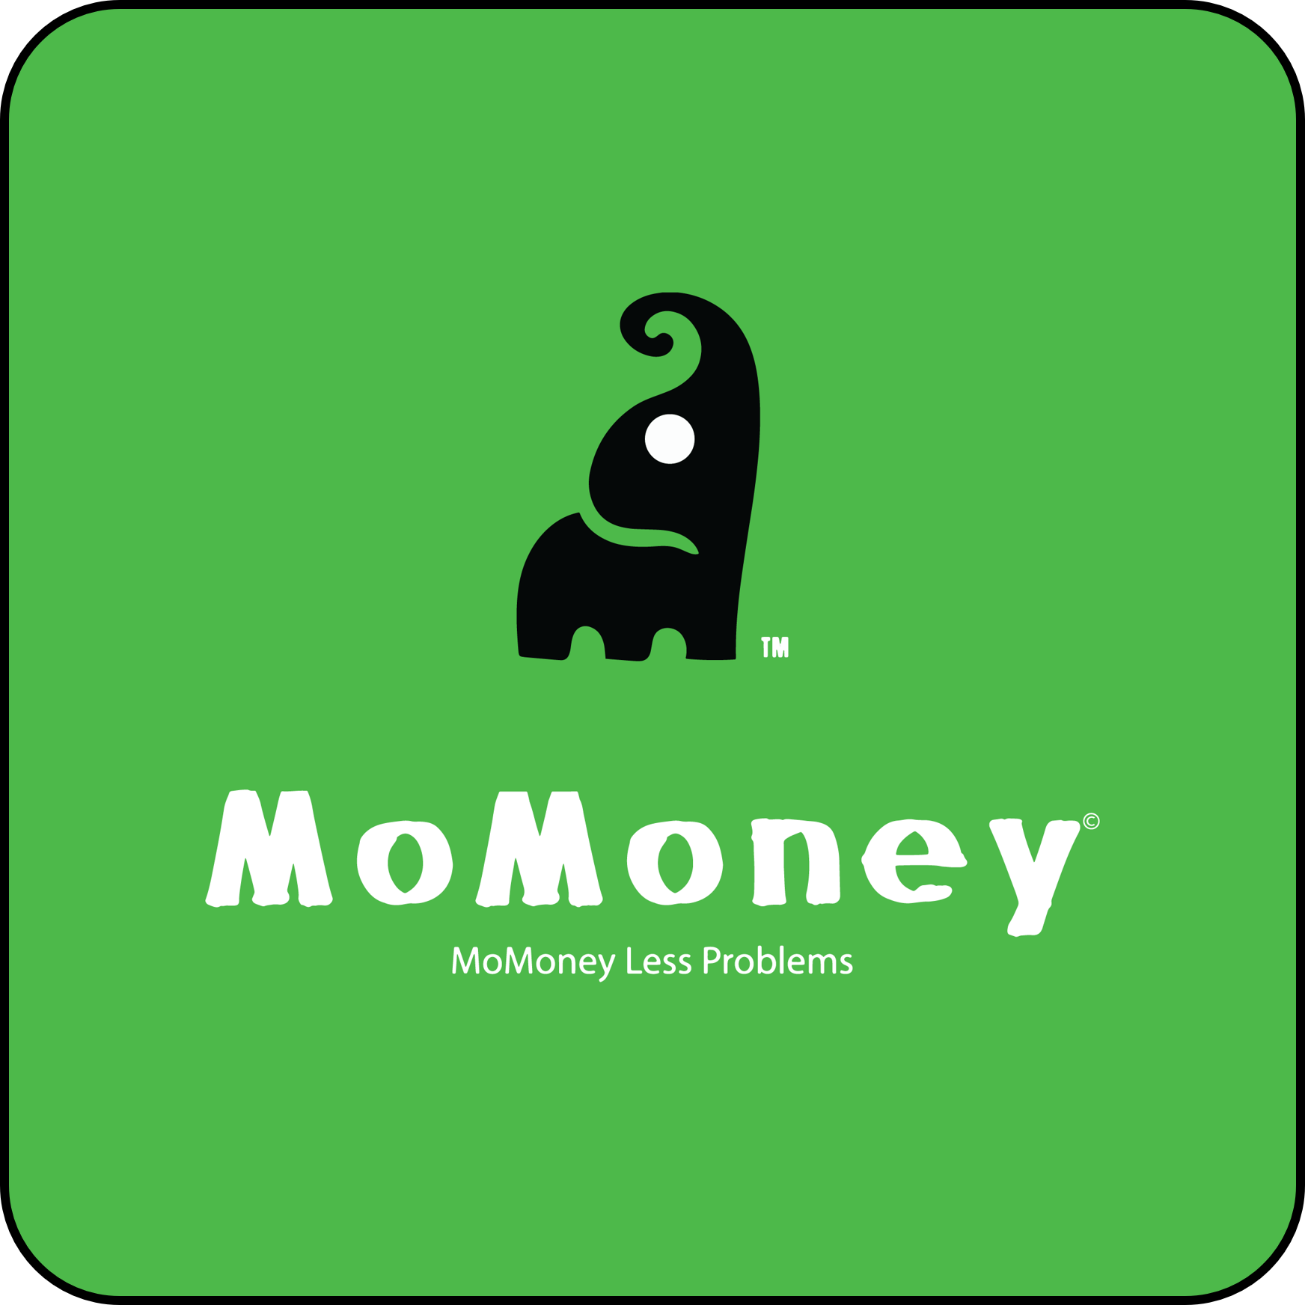

Empowering DFSPs to host PM4MLs
New DFSPs
PM4ML self-hosted by MoMoney
PM4ML hosted by ThitsaWorks
11

Slide 12
Empowering DFSPs to host PM4MLs
Steps
Created documentation to guide building of the PM4ML instance
Provided PM4ML IaC template to build in their AWS account
Organized hands-on training regarding PM4ML configurations and setup
Provided technical support regarding connectivity
Provided Payment Manager training
Built PM4ML in their own AWS account
Connected with PM4ML and their biller (CBS)
Integrated WynePay public API endpoint in their wallet
What ThitsaWorks supported
What MoMoney did

Slide 13
Making WynePay more inclusive
Payment Portal for MFIs

Slide 14
Making WynePay more inclusive
Use Case Summary MFIs using legacy systems with no access to interoperable platforms want to disburse loans to their borrowers or make payroll payments to staff with a variety of wallets.
Challenges
MFIs have to prepare different excel sheets per wallet/bank and upload them at the corresponding sites and track these with different support and monitoring services.
Time consuming & inefficient – negotiating different agreements, pricing, prepping different templates each time
Reconciling transactions is a nightmare
Tracking payment is unwieldy
80% of MFIs in Myanmar fall into one of the three categories:
No Core Banking System
Core Banking System with no API capability
Core Banking System with API capability but no IT capacity to build and maintain an integration
30+
Wallets
183
MFIs

Slide 15



Making WynePay more inclusive
Solution
MFIs access Payment Portal and make disbursements or payrolls to anyone using WynePay participants by uploading csv files. Learn to prepare one template and track and monitor all the payments (across multiple DFSPs) securely through this role-based portal. The portal provides a simple unified experience with virtually no wait time for building integration or system upgrades.
Different type of MFIs
Core Banking with APIs
PM4ML/
Mojaloop SDK/Others
Wallet A
1
Wallet B
Core Banking without API capabilities
Payment Portal
2
Wallet C
Without Core Banking
3

Slide 16
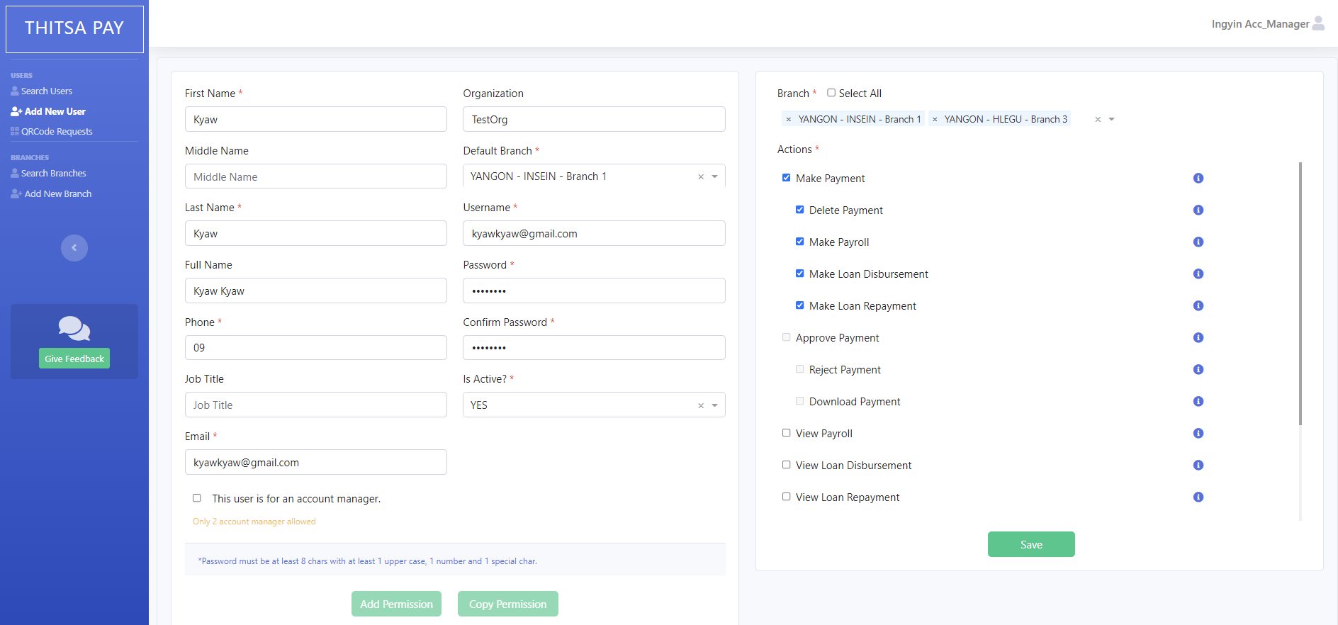
Create the roles with granular access
Grant the privilege

Slide 17
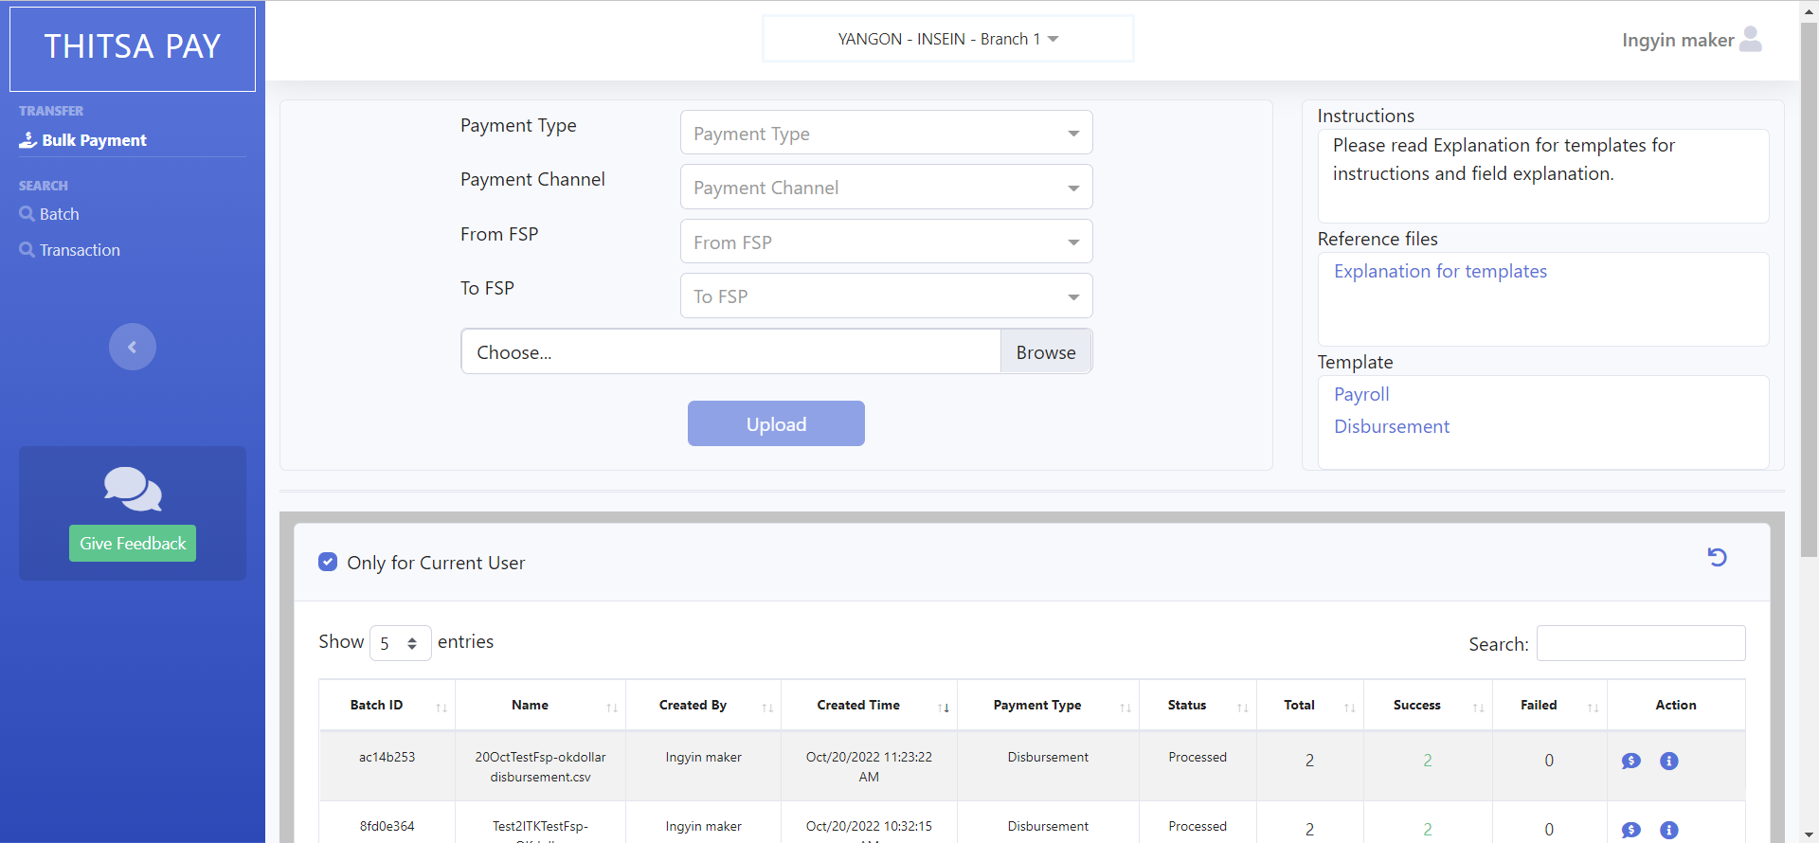
Upload CSV and view the process result
Upload CSV file for Bulk Payment
The result of the process

Slide 18
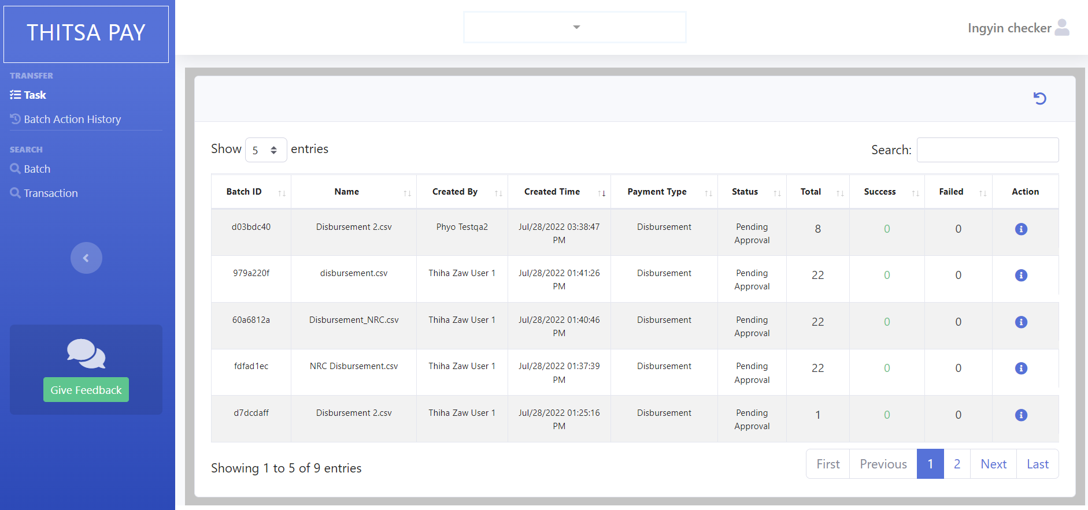
Manage the tasks
Here, checker can do:
Approve the payment
Reject the payment together with rejection reason.

Slide 19
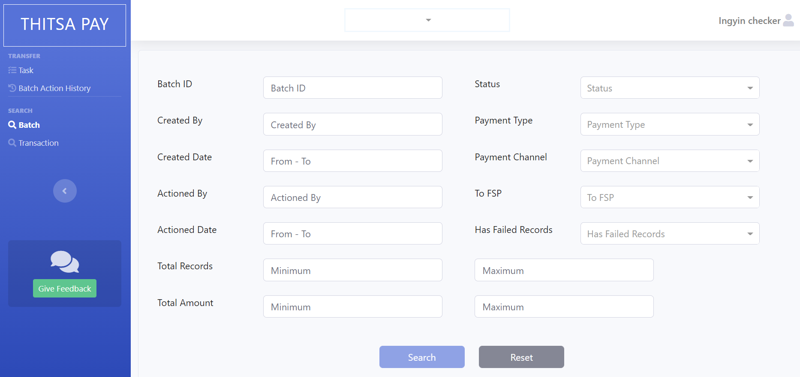
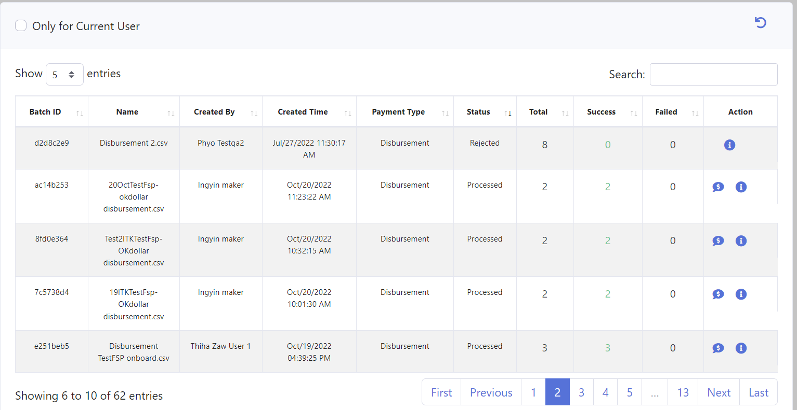
Search the transactions
Search function provides various filters to be able to extract the accurate results.
The search results will be displayed as below.

Slide 20
Roadmap: DFSP Portal
A Portal for DFSPs to monitor settlement windows and details

Slide 21

Thank you!
ModusBox team
Michael, Sam, Miguel, Vijay
Jane, Oscar, David
Paul Makin, Paul Baker
and more…
DFSPs
DFSPs in the FUT
MoMoney
CitizenPay
Mojaloop Foundation
Steve Haley
Bill & Melinda Gates Foundation
Miller Abel
21

